Slide 1

Java Programming
Present By
Poovaragavan Velumani
Java trainer
+91-6385260317
Email id : msgtovpragavan@gmail.com

Slide 2
Topics Covered
Java & Its features
Understanding Fundamentals
Difference between C, C++ and Java
Environment setup
Basics
Variables
Data Types
Operators
Input and Output
Expressions & Blocks
Comment
Flow Control
Java Arrays

Slide 3
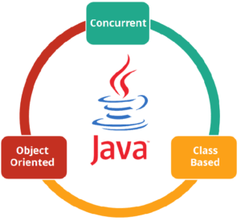
What is Java?
Java is a cross-platform object-oriented programming language that was released by Sun Microsystems in the year 1995.
Today, Java is needed to run various applications such as games, social media applications, audio and video applications, etc.
It is an object-oriented language similar to C++, but with advanced and simplified features. This language is free to access and can run on all platforms.

Slide 4
What is Java used for?
Banking: To deal with transaction management.
Retail: Billing applications that you see in a store/restaurant are completely written in Java.
Information Technology: Java is designed to solve implementation dependencies.
Android: Applications are either written in Java or use Java API.
Financial services: It is used in server-side applications.
Stock market: To write algorithms as to which company they should invest in.
Big Data: Hadoop MapReduce framework is written using Java.
Scientific and Research Community: To deal with huge amount of data.

Slide 5
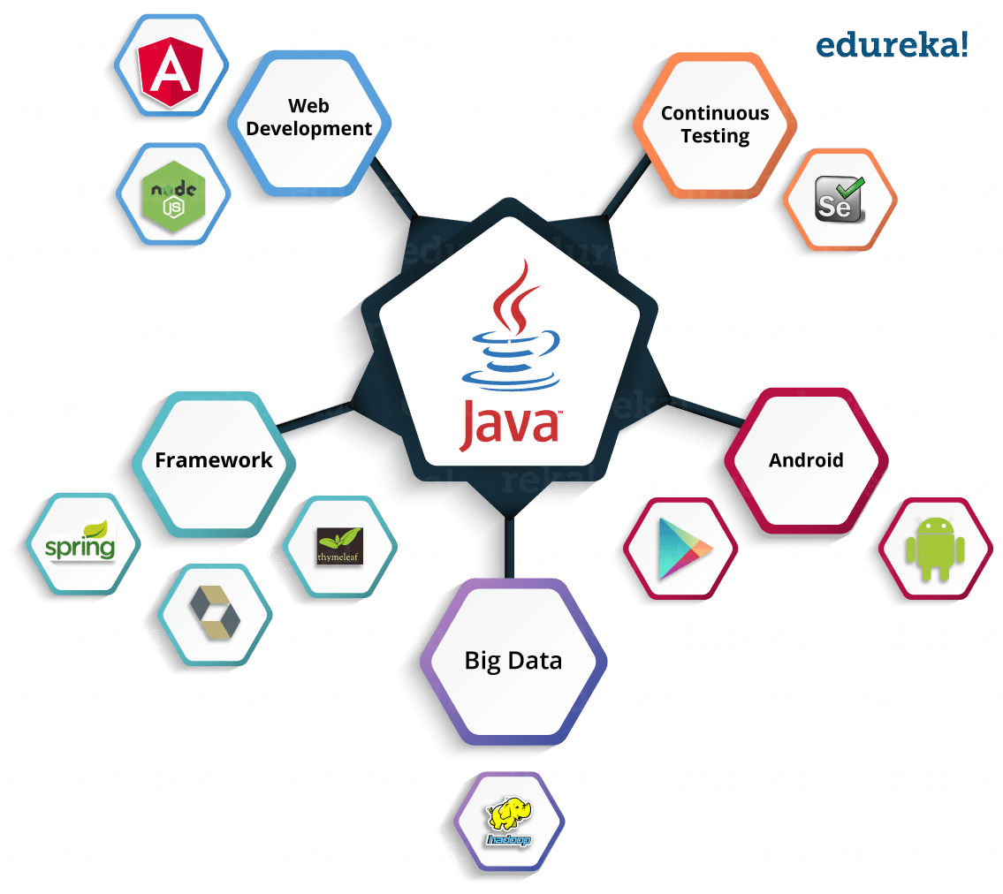
What is Java used for?
Concurrent where you can execute many statements instead of sequentially executing it.
Class-based and an object-oriented programming language.
Independent programming language that follows the logic of “Write once, Run anywhere” i.e. the compiled code can run on all platforms which supports java.
In simple words, it is a computing platform where you can develop applications.

Slide 6
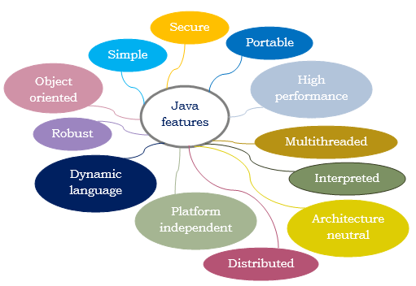
Features

Slide 7
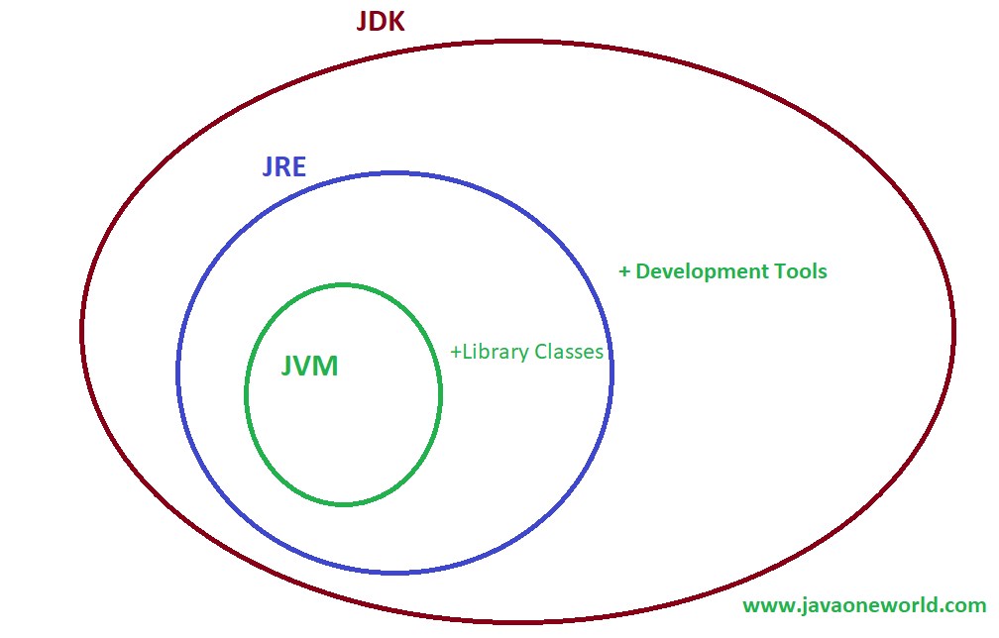
Components

Slide 8

Why Java is a Popular Programming Language?
Features !!!!!

Slide 9
Why Java is secure?
The byte-code verification before the execution takes place, therefore the program becomes unable to jump to a malicious or undefined instruction or to make a type error at the instruction level.
The automatic bounds checking of arrays null checking of references verification of casts prevents the program from making any type errors.
Whenever a new code is being loaded, run-time security checks take place. The usage of security manager and class loader makes it easy for the Java run-time to avoid any arbitrary code from executing by mediating access to the system resources and preventing the program from loading or generating any arbitrary code at run-time.
Java provides library level safety.

Slide 10
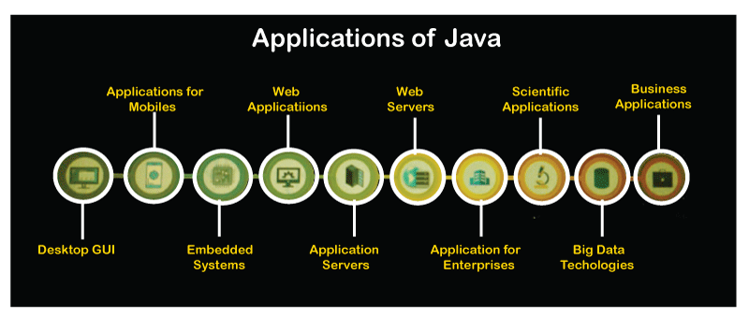
What are the different Applications of Java?

Slide 11
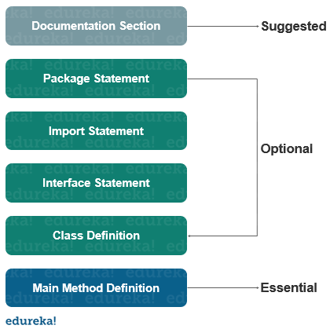
Basic Structure of a Java Program

Slide 12
Difference between C, C++ and Java?
Metrics | C | C++ | Java
Programming Paradigm | Procedural language | Object-Oriented Programming (OOP) | Pure Object Oriented Oriented
Origin | Based on assembly language | Based on C language | Based on C and C++
Developer | Dennis Ritchie in 1972 | Bjarne Stroustrup in 1979 | James Gosling in 1991
Translator | Compiler only | Compiler only | Interpreted language (Compiler + interpreter)
Platform Dependency | Platform Dependent | Platform Dependent | Platform Independent
Code execution | Direct | Direct | Executed by JVM (Java Virtual Machine)

Slide 13
Difference between C, C++ and Java?
Metrics | C | C++ | Java
File generation | .exe files | .exe files | .class files
Pre-processor directives | Support header files (#include, #define) | Supported (#header, #define) | Use Packages (import)
keywords | Support 32 keywords | Supports 63 keywords | 50 defined keywords
Datatypes (union, structure) | Supported | Supported | Not supported
Inheritance | No inheritance | Supported | Supported except Multiple inheritance
Overloading | No overloading | Support Function overloading (Polymorphism) | Operator overloading is not supported
Pointers | Supported | Supported | Not supported
Allocation | Use malloc, calloc | Use new, delete | Garbage collector

Slide 14
Difference between C, C++ and Java?
Metrics | C | C++ | Java
Exception Handling | Not supported | Supported | Supported
Templates | Not supported | Supported | Not supported
Destructors | No constructor neither destructor | Supported | Not supported
Multithreading/ Interfaces | Not supported | Not supported | Supported
Database connectivity | Not supported | Not supported | Supported
Storage Classes | Supported ( auto, extern ) | Supported ( auto, extern ) | Not supported
Exception Handling | Not supported | Supported | Supported
Templates | Not supported | Supported | Not supported

Slide 15
Java 9 Features and Improvements
Process API updates in Java 9
HTTP/2 client in Java 9
Java Shell Scripting (Read-Eval-Print-Loop) in Java 9
Multi-release JAR files feature in Java 9
More Concurrency Updates feature in Java 9
Project Jigsaw in Java 9

Slide 16
Top 10 Java Frameworks You Should Know
What are Java frameworks?
Frameworks are large bodies of pre-written code to which you add your own code in order to solve a problem. You make use of a framework by calling its methods, inheritance, and supplying callbacks, listeners, or other implementations of the patterns.
A framework will often dictate the structure of an application. Some frameworks even supply so much code that you have to do very little to write your application. This can be good or bad, depending on how easy it is to use. Frameworks are the substance of programming.
You build on top of a good one, your program is solid and fast and comes together beautifully. You build on top of a bad one, your life is miserable, brutish, and short.

Slide 17
Top 10 Java Frameworks You Should Know
Spring
Hibernate
Struts
Google web toolkit [GWT]
JavaServer Faces [JSF]
Grails
Vaadin
Blade
Dropwizard
Play

Slide 18
Get started with Java
Download & Install JDK
Download & Install either VS Code or Ecllipse
Git
Set class path

Slide 19

Java Environment Setup

Slide 20

How To Set Java Path?
Two Ways
Temporary path
Permanent path

Slide 21

Write Hello World Program
Hello World Program in Java
Syntax Analysis

Slide 22
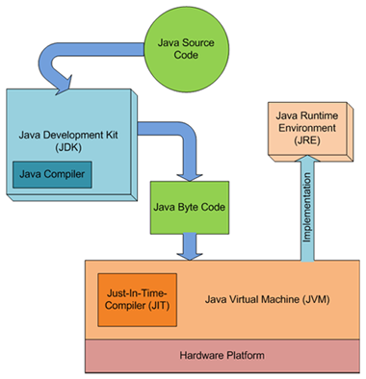
Compile and Run

Slide 23

What Are Command Line Arguments?
Java programming language is versatile in every aspect, being platform-independent it makes Java a clear cut winner for any developer.
The execution of any Java program is hustle-free and precise. We can even pass arguments during execution of a program using the command-line arguments.

Slide 24

Java Core Concepts

Slide 25

Java Variables and Data Types with EXAMPLE

Slide 26

What is a Variable in Java?
Variable in Java is a data container that stores the data values during Java program execution.
Every variable is assigned data type which designates the type and quantity of value it can hold.
Variable is a memory location name of the data. The Java variables have mainly three types : Local, Instance and Static.

Slide 27
What is a Variable in Java?
In order to use a variable in a program you to need to perform 2 steps
Variable Declaration
Variable Initialization

Slide 28
Types of variables
In Java, there are three types of variables:
Local Variables
Local Variables are a variable that are declared inside the body of a method.
Instance Variables
Instance variables are defined without the STATIC keyword .They are defined Outside a method declaration. They are Object specific and are known as instance variables.
Static Variables
Static variables are initialized only once, at the start of the program execution. These variables should be initialized first, before the initialization of any instance variables.

Slide 29
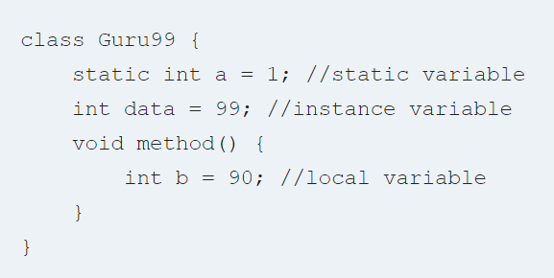
Example: Types of Variables in Java

Slide 30
What is Data Types in Java?
Data Types in Java are defined as specifiers that allocate different sizes and types of values that can be stored in the variable or an identifier.
Java has a rich set of data types.
Data types in Java can be divided into two parts.

Slide 31
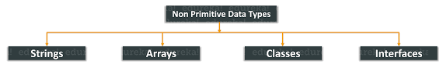
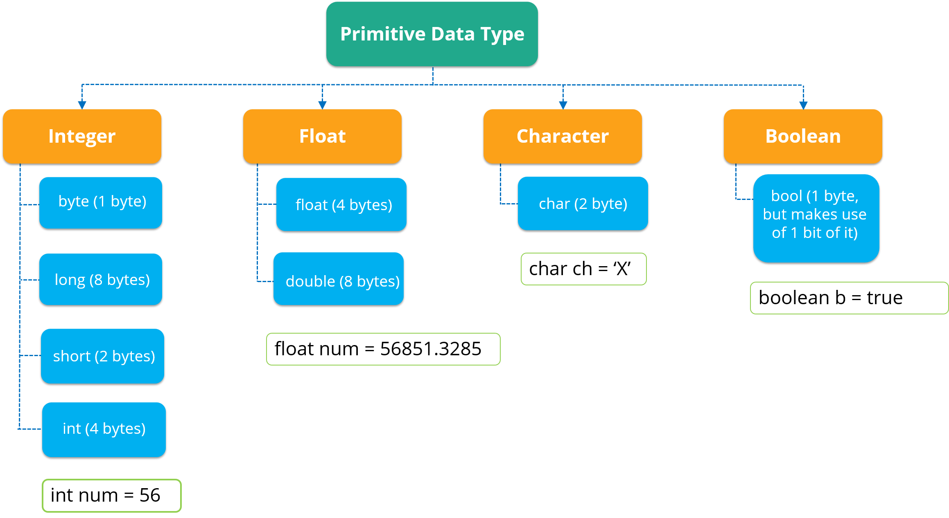
What is Data Types in Java?

Slide 32
Java Variable Type Conversion & Type Casting
A variable of one type can receive the value of another type. Here there are 2 cases
Automatic Conversion
type cast operator

Slide 33
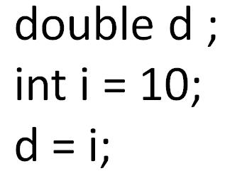
Automatic Conversion
Variable of smaller capacity is be assigned to another variable of bigger capacity.
This process is Automatic, and non-explicit is known as Conversion

Slide 34
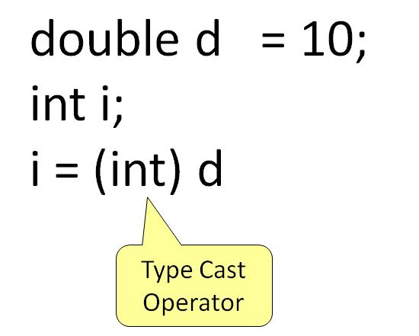
Type Casting
Variable of larger capacity is be assigned to another variable of smaller capacity.
In such cases, you must explicitly specify the type cast operator. This process is known as Type Casting.

Slide 35

Java Operators

Slide 36
Operators(Symbols)
Operators are symbols that perform operations on variables and values.
Operators in Java can be classified into 5 types:
Arithmetic Operators
Assignment Operators
Relational Operators
Logical Operators
Unary Operators
Bitwise Operators

Slide 37
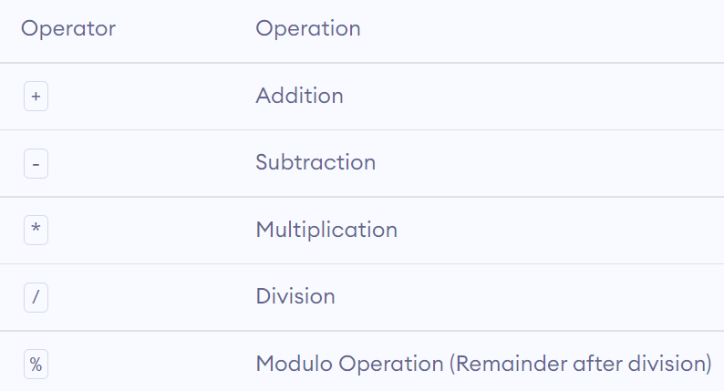
Arithmetic Operators
Arithmetic operators are used to perform arithmetic operations on variables and data.

Slide 38
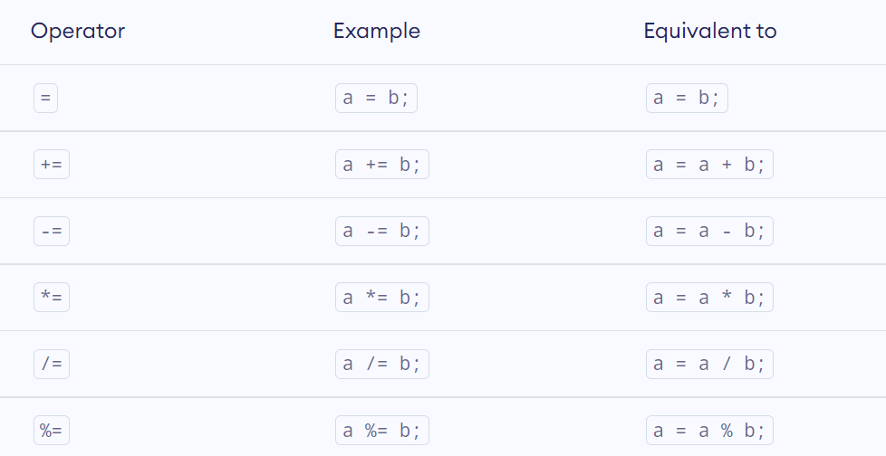
Assignment Operators

Slide 39
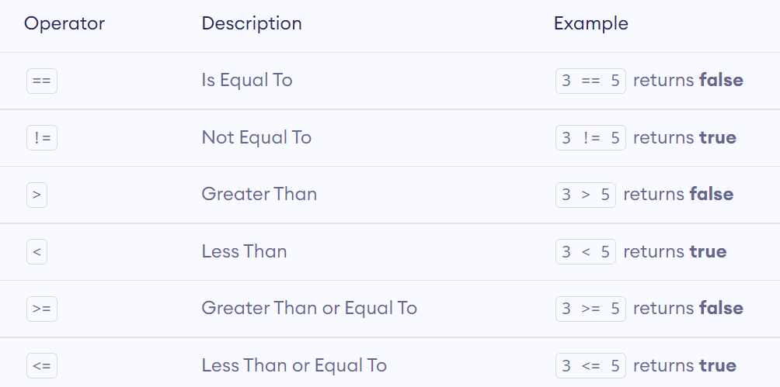
Relational Operators
Relational operators are used to check the relationship between two operands.
It returns either true or false.

Slide 40
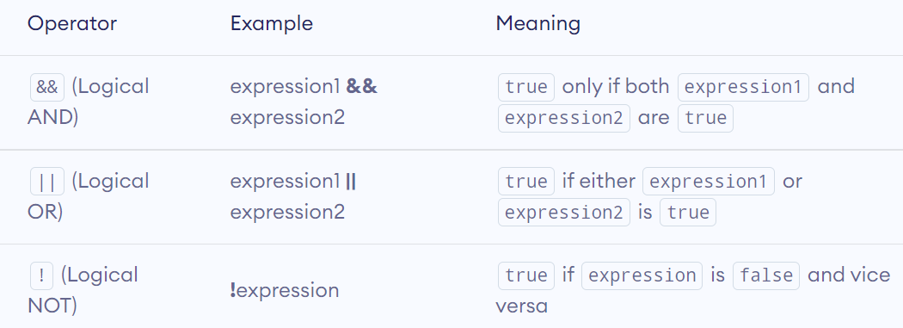
Logical Operators
Logical operators are used to check whether an expression is true or false.
They are used in decision making.

Slide 41
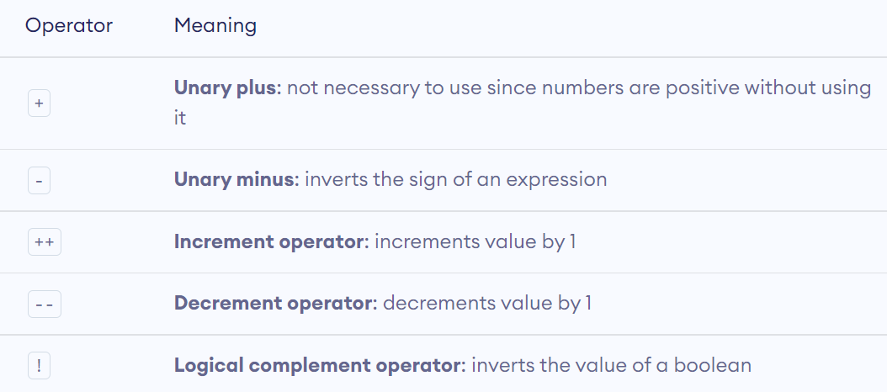
Unary Operators
Unary operators are used with only one operand.
For example, ++ is a unary operator that increases the value of a variable by 1.
That is, ++5 will return 6.

Slide 42
Increment and Decrement Operators
Java also provides increment and decrement operators: ++ and -- respectively. ++ increases the value of the operand by 1, while -- decrease it by 1.
In programming (Java, C, C++, JavaScript etc.), the increment operator ++ increases the value of a variable by 1. Similarly, the decrement operator -- decreases the value of a variable by 1.

Slide 43
++ and -- operator as prefix and postfix
If you use the ++ operator as a prefix like: ++var, the value of var is incremented by 1; then it returns the value.
If you use the ++ operator as a postfix like: var++, the original value of var is returned first; then var is incremented by 1.
The -- operator works in a similar way to the ++ operator except -- decreases the value by 1.

Slide 44
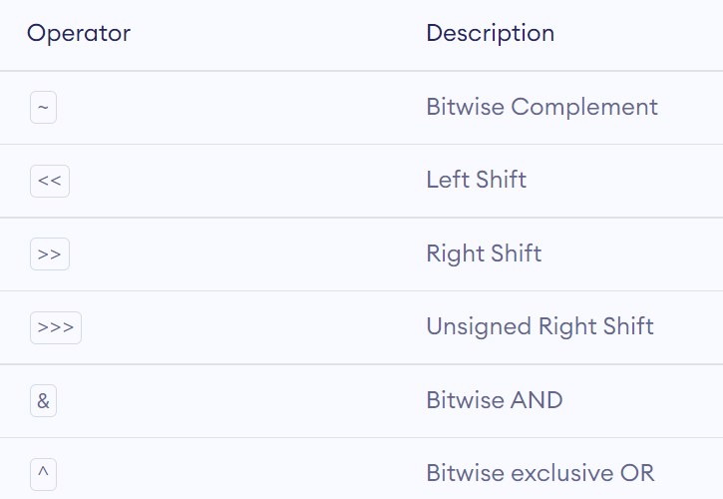
Bitwise Operators
Bitwise operators in Java are used to perform operations on individual bits.

Slide 45
Other operators
instanceof
The instanceof operator checks whether an object is an instanceof a particular class.
Ternary
The ternary operator (conditional operator) is shorthand for the if-then-else statement

Slide 46

Basic Input and Output

Slide 47
Java Output
In Java, you can simply use
System.out.println();
System.out.print();
System.out.printf();

Slide 48
Difference between println(), print() and printf()
print() - It prints string inside the quotes.
println() - It prints string inside the quotes similar like print() method. Then the cursor moves to the beginning of the next line.
printf() - It provides string formatting (similar to printf in C/C++ programming).

Slide 49

Java Input
Java provides different ways to get input from the user.
In order to use the object of Scanner, we need to import java.util.Scanner package.
import java.util.Scanner;
Then, we need to create an object of the Scanner class.
We can use the object to take input from the user.

Slide 50
Import java.util.scanner;
we have created an object named input of the Scanner class. We then call the nextInt() method of the Scanner class to get an integer input from the user.
Similarly, we can use nextLong(), nextFloat(), nextDouble(), and next() methods to get long, float, double, and string input respectively from the user.
Note: We have used the close() method to close the object. It is recommended to close the scanner object once the input is taken.

Slide 51
Expressions, Statements and Blocks
Java Expressions
A Java expression consists of variables, operators, literals, and method calls. To know more about method calls, visit Java methods.
Java Statements
In Java, each statement is a complete unit of execution.
Expression statements
We can convert an expression into a statement by terminating the expression with a ;. These are known as expression statements.
Declaration Statements
In Java, declaration statements are used for declaring variables.
Java Blocks
A block is a group of statements (zero or more) that is enclosed in curly braces { }

Slide 52
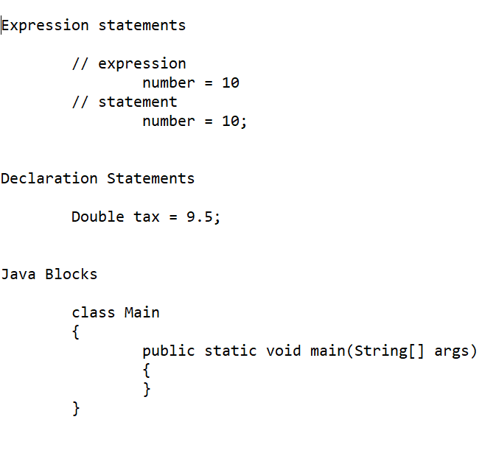
Expressions, Statements and Blocks

Slide 53

Java Comments
Types of Comments in Java
In Java, there are two types of comments:
single-line comment -> //
multi-line comment -> /* */
Doc-line comment -> /** */

Slide 54

Flow Control

Slide 55
if...else Statement
In programming, we use the if..else statement to run a block of code among more than one alternatives.
We can also use Java Strings as the test condition.
For example, assigning grades (A, B, C) based on the percentage obtained by a student.
if the percentage is above 90, assign grade A
if the percentage is above 75, assign grade B
if the percentage is above 65, assign grade C

Slide 56
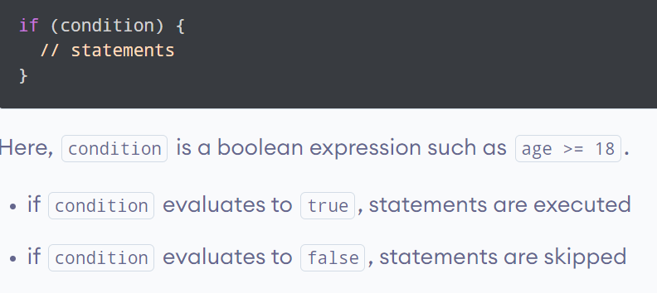
Java if (if-then) Statement

Slide 57
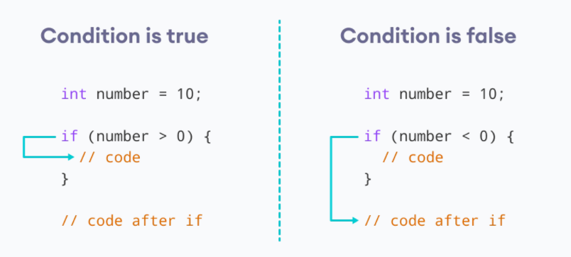
Working of if Statement

Slide 58
Java if with String
We can also use Java Strings as the test condition.

Slide 59
Java if...else (if-then-else) Statement
The if statement executes a certain section of code if the test expression is evaluated to true.
However, if the test expression is evaluated to false, it does nothing.
In this case, we can use an optional else block. Statements inside the body of else block are executed if the test expression is evaluated to false.
This is known as the if-...else statement in Java.

Slide 60
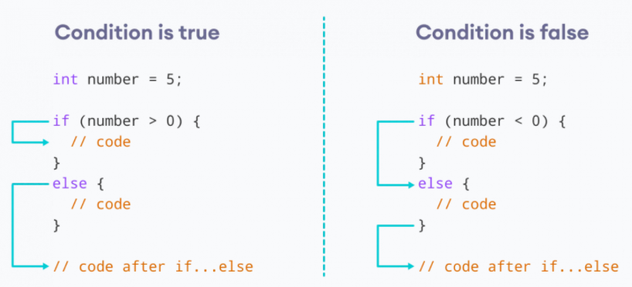
How the if...else statement works?

Slide 61

Java if...else...if Statement
In Java, we have an if...else...if ladder, that can be used to execute one block of code among multiple other blocks.
Here, if statements are executed from the top towards the bottom. When the test condition is true, codes inside the body of that if block is executed. And, program control jumps outside the if...else...if ladder.
If all test expressions are false, codes inside the body of else are executed.
Note: Java provides a special operator called ternary operator, which is a kind of shorthand notation of if...else...if statement. To learn about the ternary operator, visit Java Ternary Operator.

Slide 62
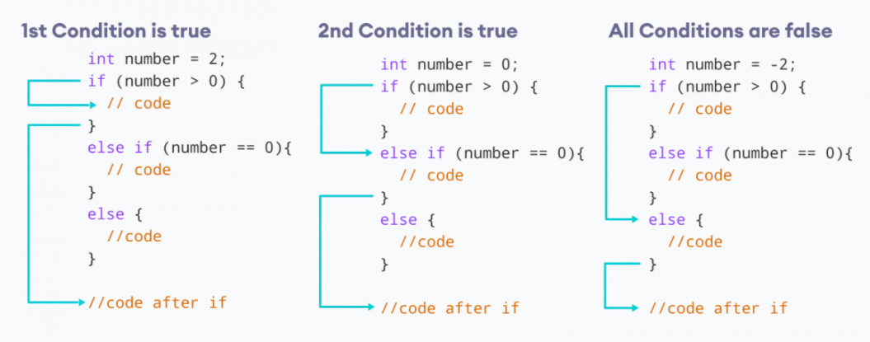
How the if...else...if ladder works?

Slide 63
Java Nested if..else Statement
In Java, it is also possible to use if.. else statements inside an if... else statement.
It's called the nested if...else statement.
Here's a program to find the largest of 3 numbers using the nested if...else statement.

Slide 64
Nested if...else Statement Example
In real-world applications, these values may come from user input data, log files, form submission, etc.

Slide 65
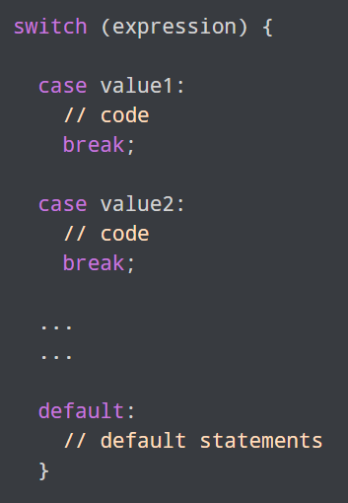
Java switch Statement
The switch statement allows us to execute a block of code among many alternatives.

Slide 66
How does the switch-case statement work?
The expression is evaluated once and compared with the values of each case.
If expression matches with value1, the code of case value1 are executed. Similarly, the code of case value2 is executed if expression matches with value2.
If there is no match, the code of the default case is executed.
Note: The working of the switch-case statement is similar to the Java if...else...if ladder. However, the syntax of the switch statement is cleaner and much easier to read and write.

Slide 67
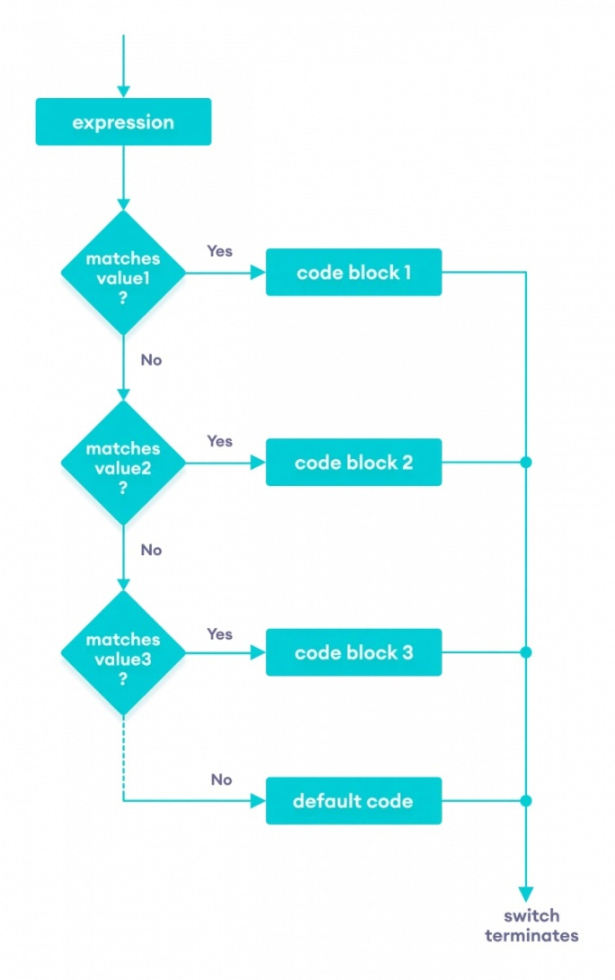
Flowchart of switch Statement

Slide 68
break statement in Java switch...case
The break statement is used to terminate the switch-case statement.
If break is not used, all the cases after the matching case are also executed.

Slide 69
default case in Java switch-case
The switch statement also includes an optional default case. It is executed when the expression doesn't match any of the cases.

Slide 70

Example for switch case

Slide 71

Java for Loop
In computer programming, loops are used to repeat a block of code. For example, if you want to show a message 100 times, then rather than typing the same code 100 times, you can use a loop.
In Java, there are three types of loops.
for loop
while loop
do...while loop

Slide 72

Java for Loop
Java for loop is used to run a block of code for a certain number of times.
The initialExpression initializes and/or declares variables and executes only once.
The condition is evaluated. If the condition is true, the body of the for loop is executed.
The updateExpression updates the value of initialExpression.
The condition is evaluated again. The process continues until the condition is false.

Slide 73
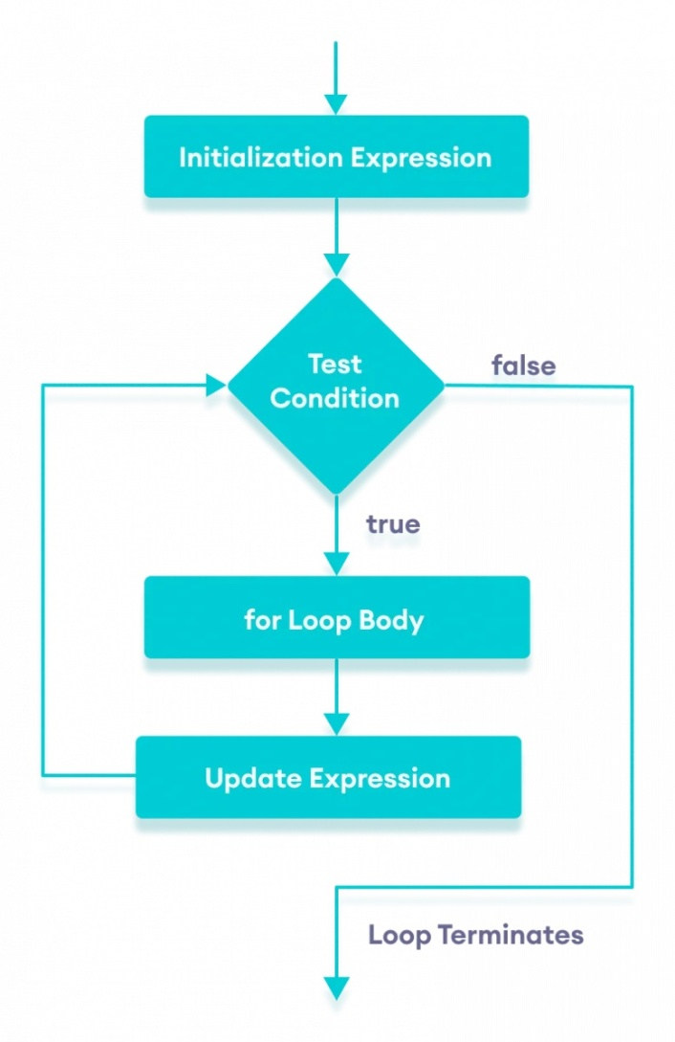
Flowchart of Java for loop

Slide 74
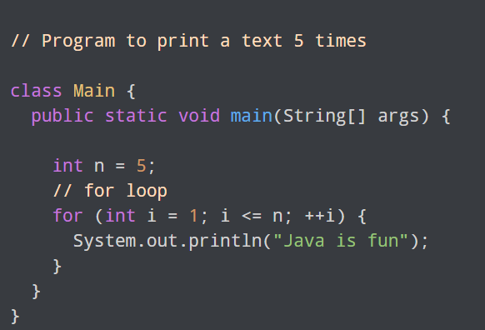
Example 1: Display a Text Five Times

Slide 75
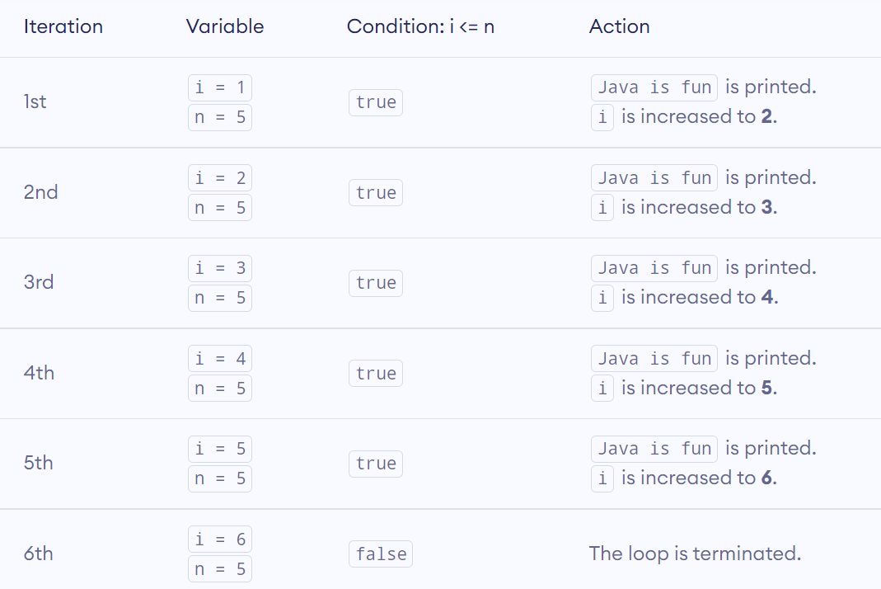
How above Code works

Slide 76
Practice
Display Sum of n Natural Numbers
Display numbers from 1 to 5

Slide 77
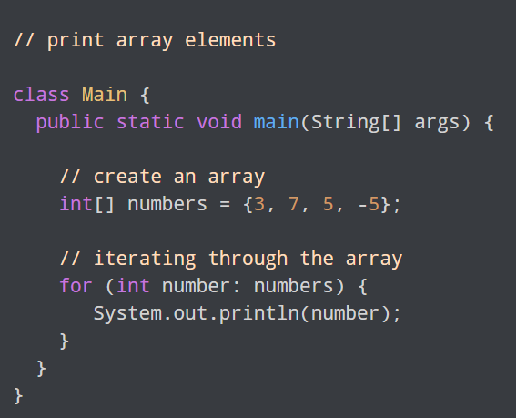
Java for-each Loop
The Java for loop has an alternative syntax that makes it easy to iterate through arrays and collections.
For example,
Here, we have used the for-each loop to print each element of the numbers array one by one.
In the first iteration of the loop, number will be 3, number will be 7 in second iteration and so on.

Slide 78
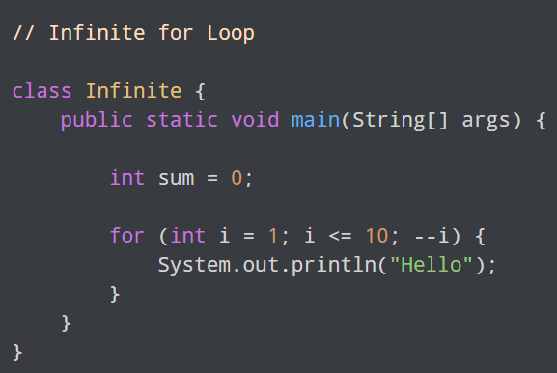
Java Infinite for Loop
If we set the test expression in such a way that it never evaluates to false, the for loop will run forever.
This is called infinite for loop. For example,

Slide 79
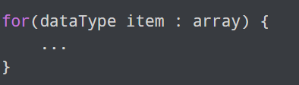
Java for-each Loop
In Java, the for-each loop is used to iterate through elements of arrays and collections (like ArrayList). It is also known as the enhanced for loop.
for-each Loop Syntax
array - an array or a collection
item - each item of array/collection is assigned to this variable
dataType - the data type of the array/collection

Slide 80
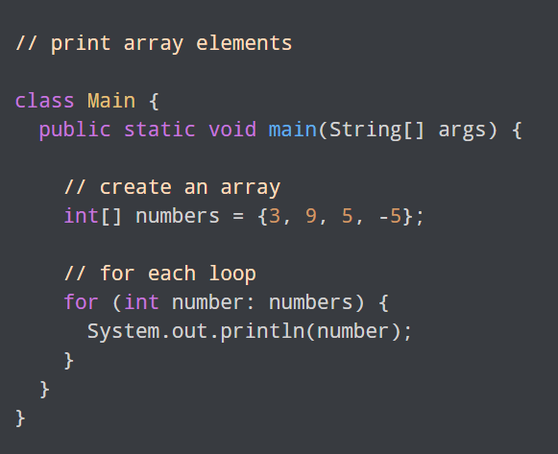
For Each example - Print Array Elements

Slide 81
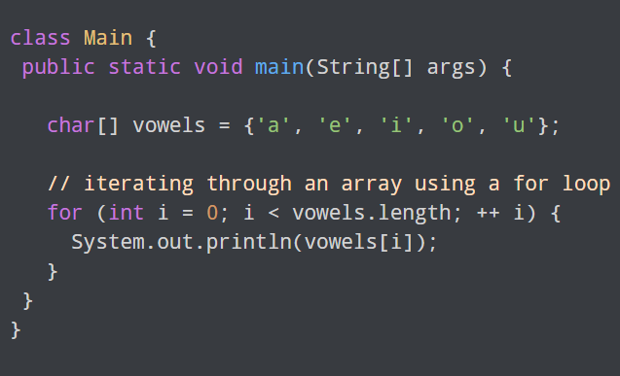
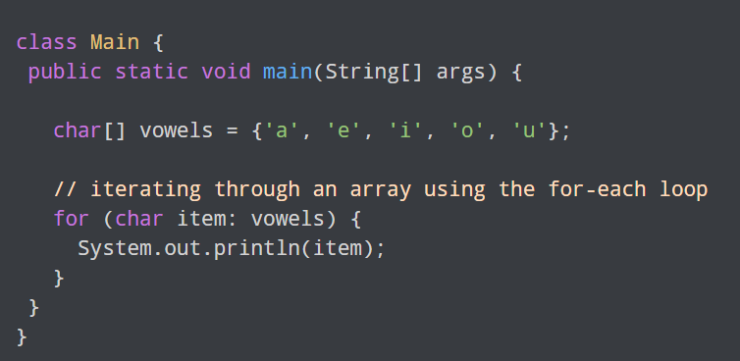
for loop Vs for-each loop
Using for loop
Using for-each Loop

Slide 82
for loop Vs for-each loop
Here, the output of both programs is the same. However, the for-each loop is easier to write and understand.
This is why the for-each loop is preferred over the for loop when working with arrays and collections.

Slide 83
while and do...while Loop
In computer programming, loops are used to repeat a block of code. For example, if you want to show a message 100 times, then you can use a loop. It's just a simple example; you can achieve much more with loops.

Slide 84
Java while loop
Java while loop is used to run a specific code until a certain condition is met.

Slide 85
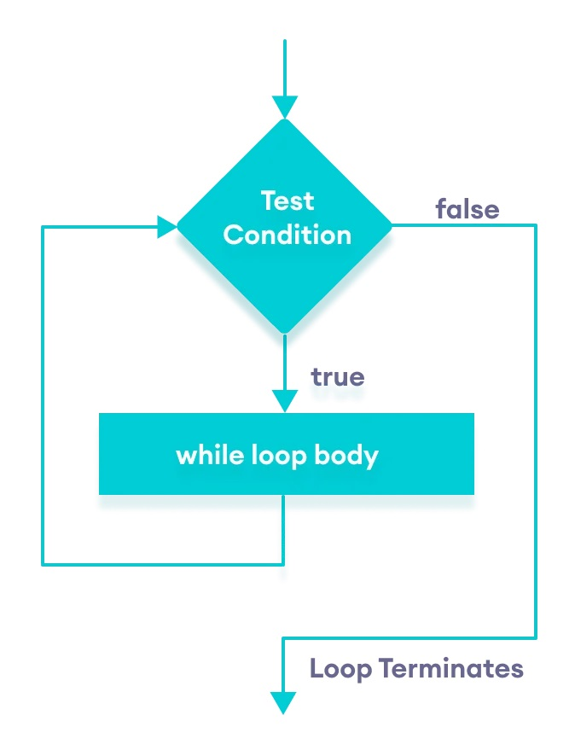
Flowchart of while loop
A while loop evaluates the textExpression inside the parenthesis ().
If the textExpression evaluates to true, the code inside the while loop is executed.
The textExpression is evaluated again.
This process continues until the textExpression is false.
When the textExpression evaluates to false, the loop stops.

Slide 86
Java do...while loop
The do...while loop is similar to while loop. However, the body of do...while loop is executed once before the test expression is checked.

Slide 87
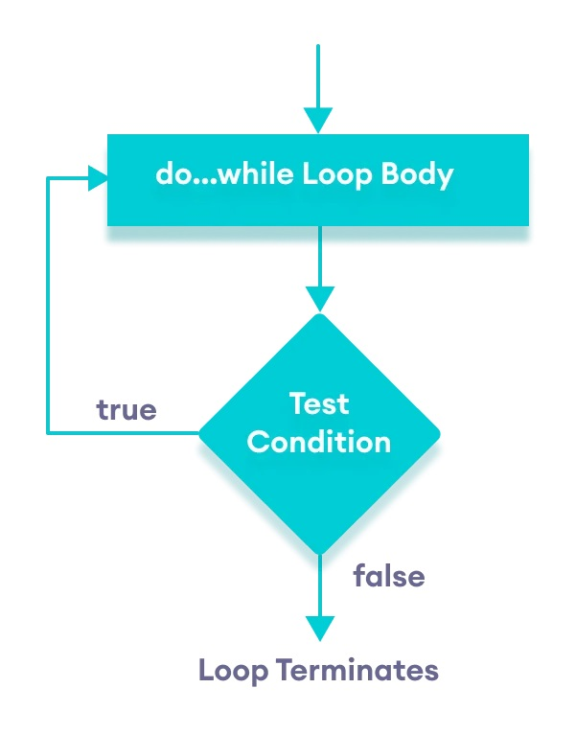
Java do...while loop
The body of the loop is executed at first.
Then the textExpression is evaluated.
If the textExpression evaluates to true, the body of the loop inside the do statement is executed again.
The textExpression is evaluated once again
.If the textExpression evaluates to true, the body of the loop inside the do statement is executed again.
This process continues until the textExpression evaluates to false. Then the loop stops.

Slide 88
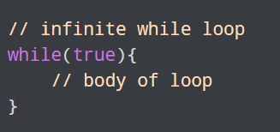
Infinite while loop
If the condition of a loop is always true, the loop runs for infinite times (until the memory is full).

Slide 89
Break & Continue
While working with loops, it is sometimes desirable to skip some statements inside the loop or terminate the loop immediately without checking the test expression.
In such cases, break and continue statements are used.

Slide 90
Java break Statement
The break statement in Java terminates the loop immediately, and the control of the program moves to the next statement following the loop.
It is almost always used with decision-making statements (Java if...else Statement).
Syntax : break;

Slide 91
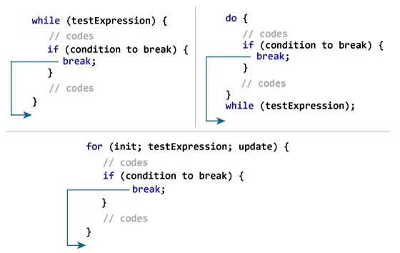
How break statement works?

Slide 92
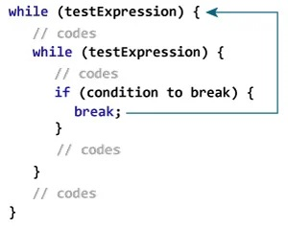
Java break and Nested Loop
In the case of nested loops, the break statement terminates the innermost loop.
Here, the break statement terminates the innermost while loop, and control jumps to the outer loop.

Slide 93
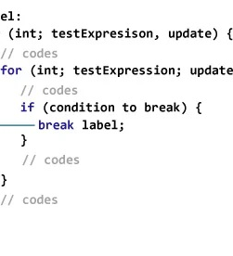
Labeled break Statement
We can use the labeled break statement to terminate the outermost loop as well.
Note: The break statement is also used to terminate cases inside the switch statement.

Slide 94
Java continue
The continue statement skips the current iteration of a loop (for, while, do...while, etc).
After the continue statement, the program moves to the end of the loop. And, test expression is evaluated (update statement is evaluated in case of the for loop).
The continue statement is almost always used in decision-making statements (if...else Statement).

Slide 95
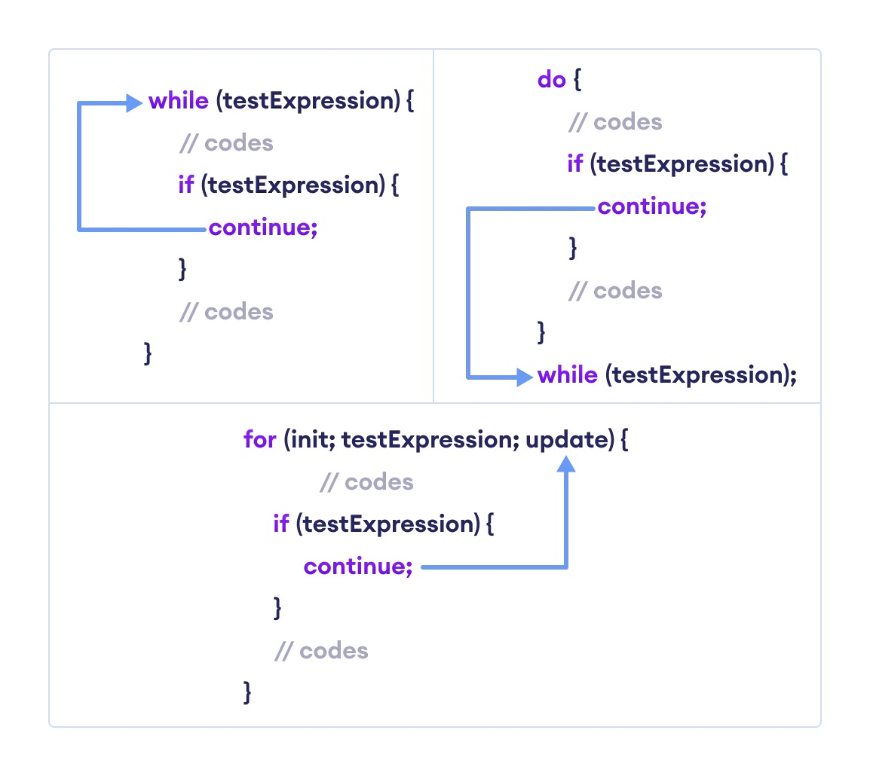
Working of Java continue statement

Slide 96
Java Operator Precedence
Operator precedence determines the order in which the operators in an expression are evaluated.

Slide 97

Arrays Declare, Create, Initialize

Slide 98

What is Java Array?
Java Array is a very common type of data structure which contains all the data values of the same data type.
The data items put in the array are called elements and the first element in the array starts with index zero.
Arrays inherit the object class and implement the serializable and cloneable interfaces. We can store primitive values or objects in an array.

Slide 99

Array Variables
Using an array in your program is a 3 step process –
Declaring your Array
Constructing your Array
Initialize your Array

Slide 100
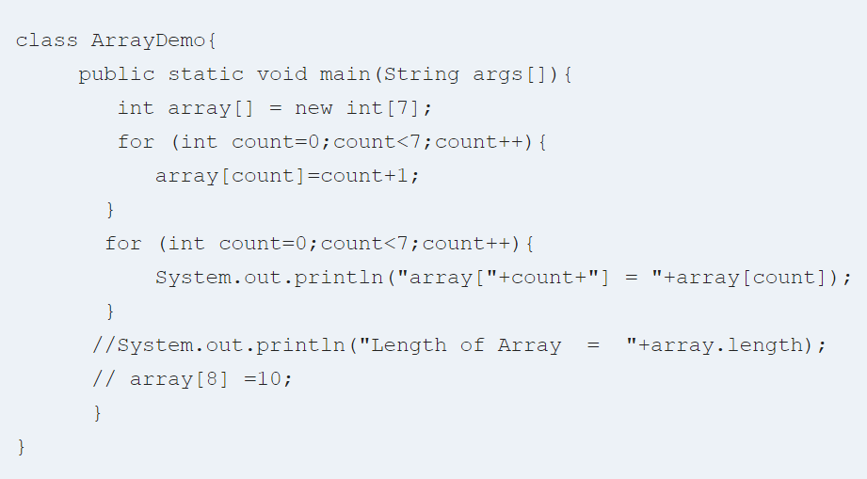
Array Program

Slide 101
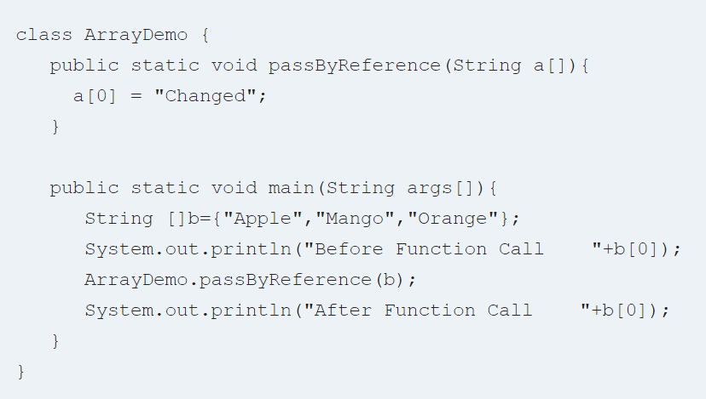
Java Array: Pass by reference
Arrays are passed to functions by reference, or as a pointer to the original. This means anything you do to the Array inside the function affects the original.

Slide 102
Multidimensional arrays
Multidimensional arrays are actually arrays of arrays. To declare a multidimensional array variable, specify each additional index using another set of square brackets.
When you allocate memory for a multidimensional array, you need only specify the memory for the first (leftmost) dimension.
You can allocate the remaining dimensions separately.
In Java, array length of each array in a multidimensional array is under your control.

Slide 103

Create Array of Objects in Java

Slide 104

What Is An Array Of Objects?
JAVA ARRAY OF OBJECT, as defined by its name, stores an array of objects. Unlike a traditional array that store values like string, integer, Boolean, etc an array of objects stores OBJECTS. The array elements store the location of the reference variables of the object.
Syntax:
Class obj[]= new Class[array_length]

Slide 105
What is ArrayList in Java?
ArrayList in Java is a data structure that can be stretched to accommodate additional elements within itself and shrink back to a smaller size when elements are removed. It is a very important data structure useful in handling the dynamic behavior of elements.

Slide 106
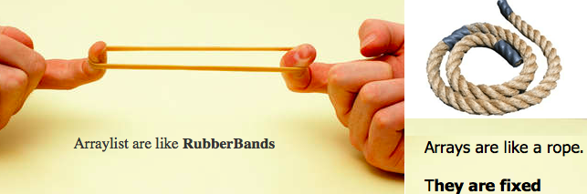

Slide 107
ArrayList Methods
ArrayList add
Syntax:add(Object o);
ArrayList remove
Syntax:remove(Object o);
Java array size
Syntax:int size();
ArrayList contains
Syntax:boolean contains(Object o);

Slide 108
Java ArrayList Example

